Slide 1
TweetWorld Status
Status
  Runway
  Bird Condition
Gunshy Status
  Runway
  Bird Condition
ITS Condition
Alternate / LND
Slots @ 0930
31
Low
Unrestricted
31
Low
Normal
MEI/825

Slide 2
REMARKS / TOLD
Remarks:
Supervisor / Top 3
TOLD
  NWLO/RS
  T/O / Formation
  Normal Landing
  HW No Flap
Runway Condition
Russell/Carlin
65 90+/90
1900/ 2185
2705
3246
Dry

Slide 3
NOTAMS
IN OTS NOTAMS
ILS
VOR
DME
IGB
MEI
TUP
TCL
GWO
X
X
X
X
X |  | 10 DME Arc
X
X
X

Slide 4
BAM/AHAS
Low Mod Sev
TUP
TCL
MEI
GWO
GTR
SR-137
VR-1014
X
X
X
 | X
X
 | X
 | X

Slide 5
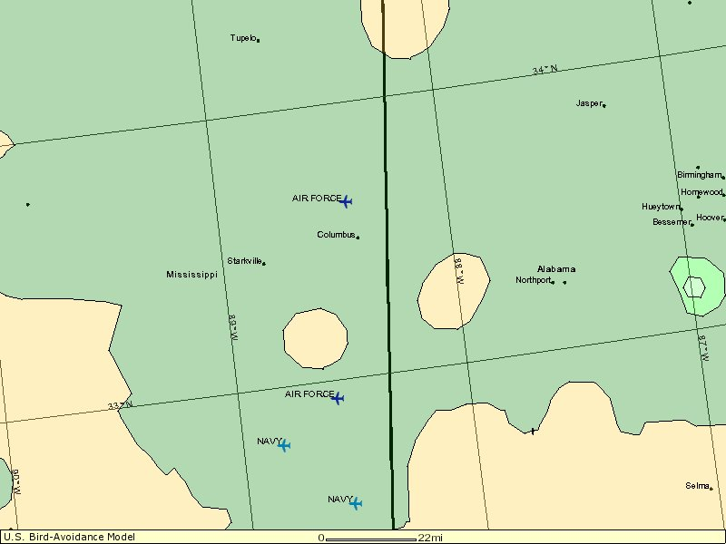
BAM
VR 1014
VR1014
TUP
CBM
LOW
MOD
SR 137
SR137
TCL
SEV
GUNSHY
MEI

Slide 6
Jets / Sims For Sale
Jets For Sale Mon:
Jets For Sale Tue:
Sims For Sale
1115(6)

Slide 7
TweetWorld Notes
387.0 (CH 7) OTS use 291.65
Capt Beplay’s Going-Away Dinner – Monday 1700 @ Mi Toro’s
Click Here To Refresh

